Slide 1
AI Innovators Capstone Project (DRAFT)
By Alex Temple and Seth Bickham

Slide 2
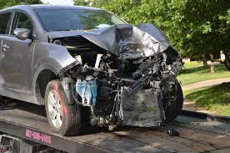
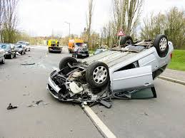
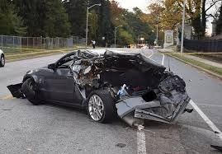
The Problem.
Motor vehicle accidents often leave victims unable to call for help, causing dangerous delays in emergency response.

Slide 3

The SOLUTION.
An AI-powered detection system that instantly identifies vehicle accidents and automatically alerts authorities to ensure rapid emergency response.
The system uses a mobile AI module that is in the car. The program monitors sensor data to detect crash-level impacts in real time. AI will continuously monitor sensor data (tracking sudden deceleration and impact force) to detect when a collision occurs.
Once detected, the system will automatically contact 911 with the vehicle’s location and crash details, ensuring rapid emergency response without requiring user action.

Slide 4



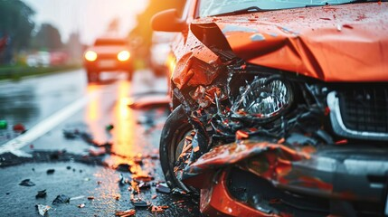
How it Works.

Slide 5
AI

Slide 6
Market

Slide 7
ethics

Slide 8
Slide 3 (car crash images) - Free Stock Images

